Slide 1
Fuzzy Controller

Slide 2
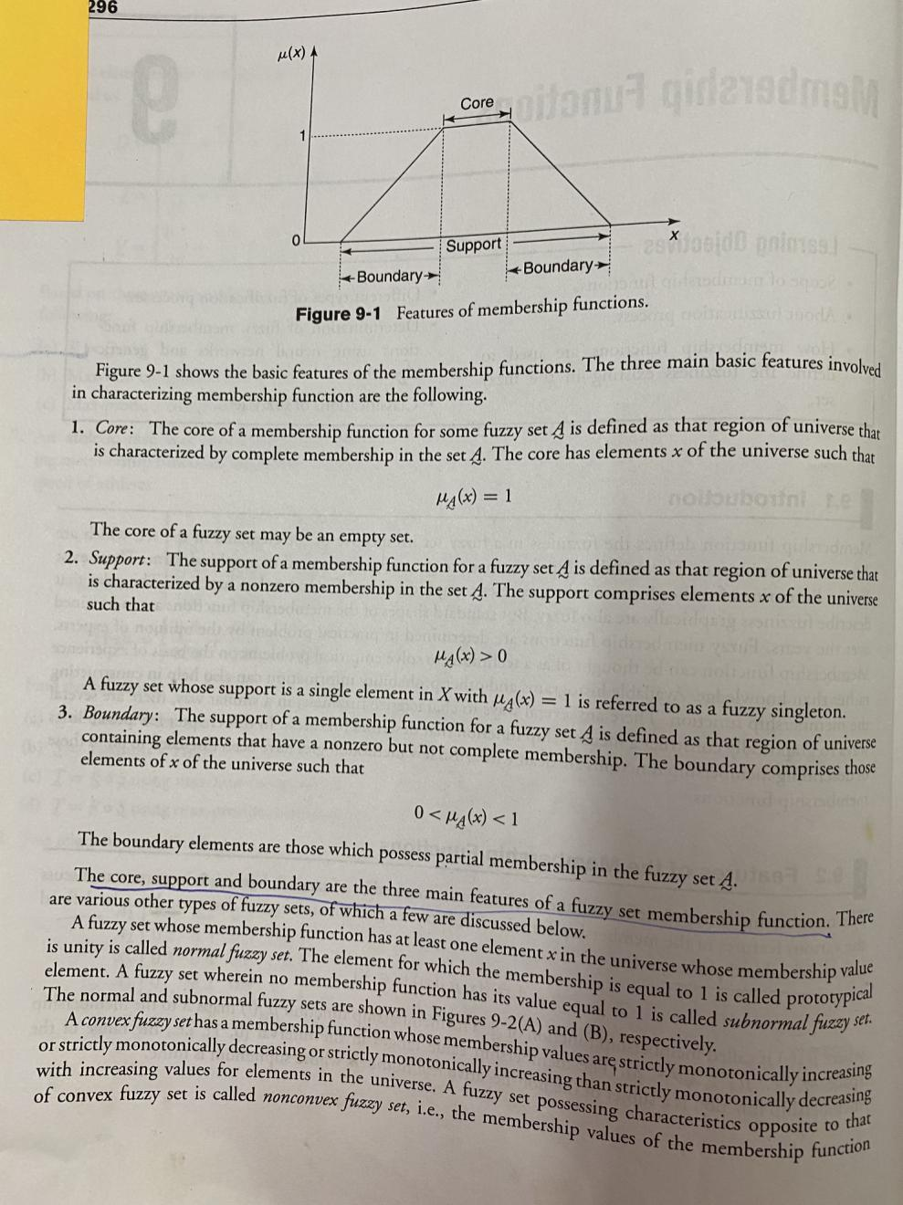
Features of Membership Functions: Core , Support and Boundary

Slide 3
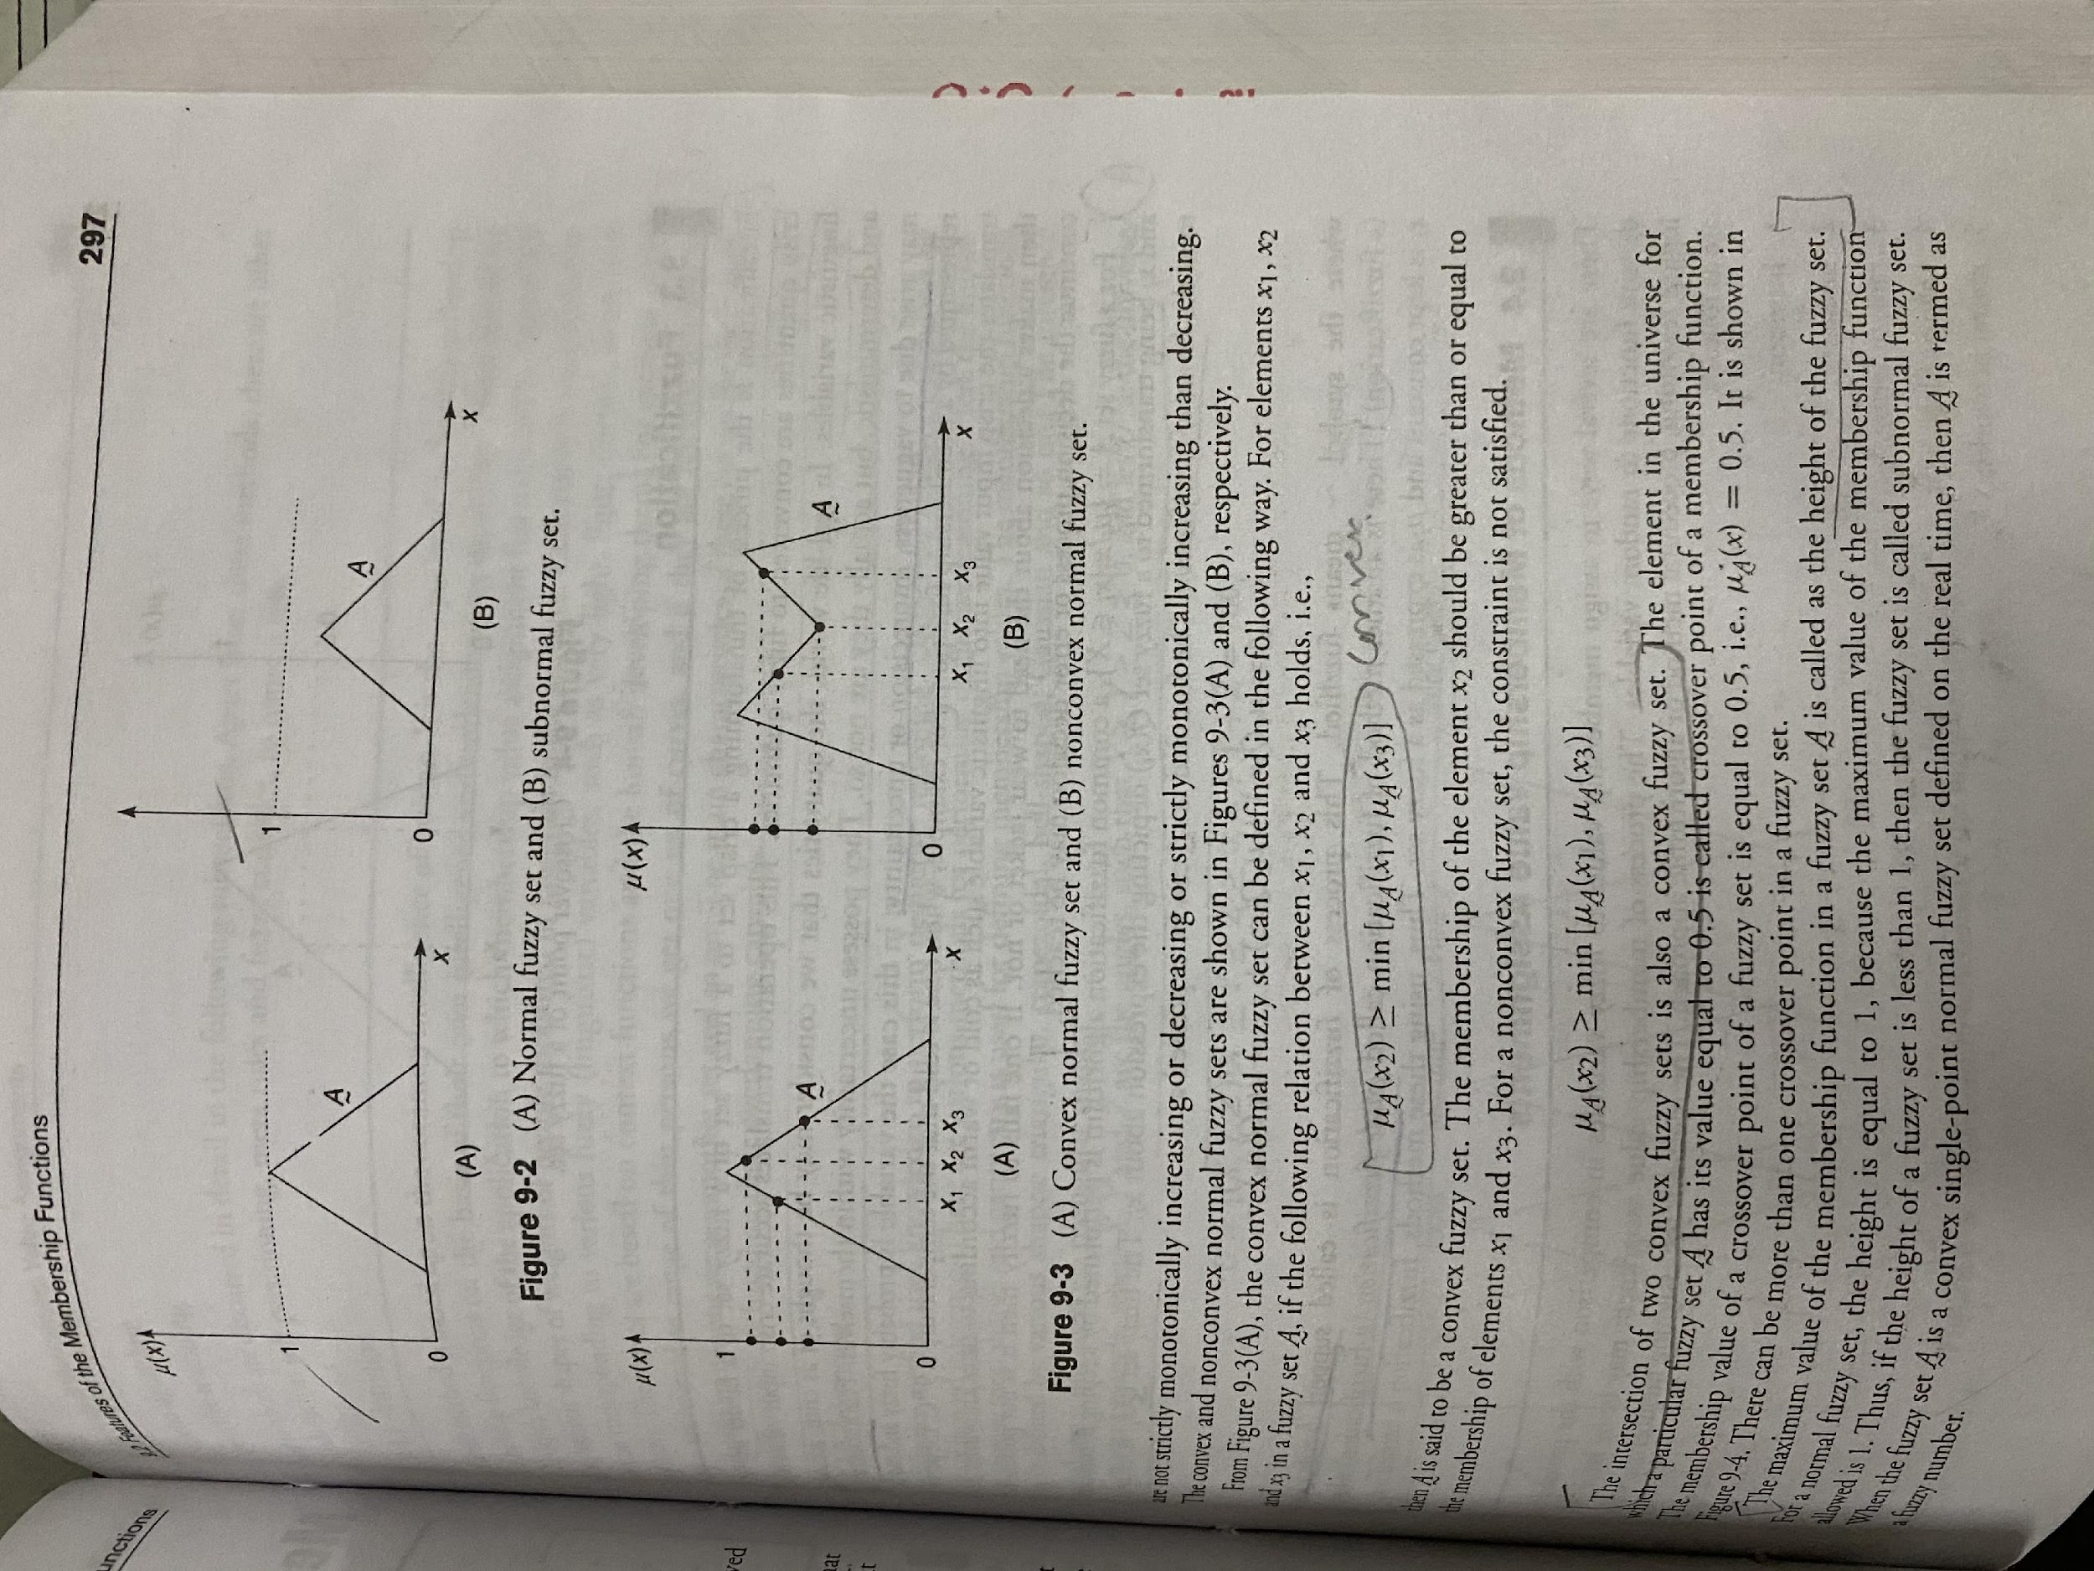

Slide 4
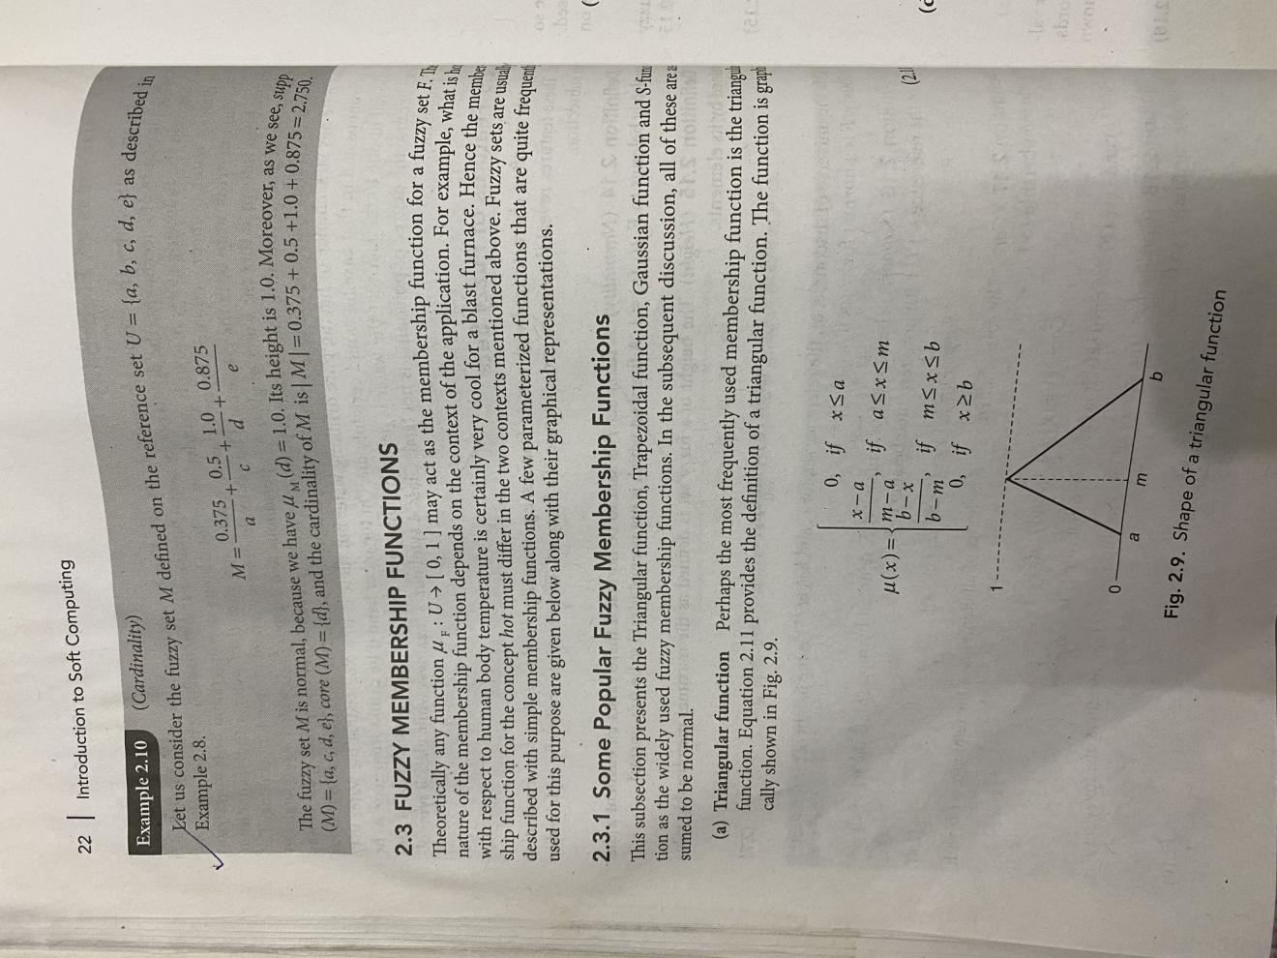
Some Popular Membership function

Slide 5
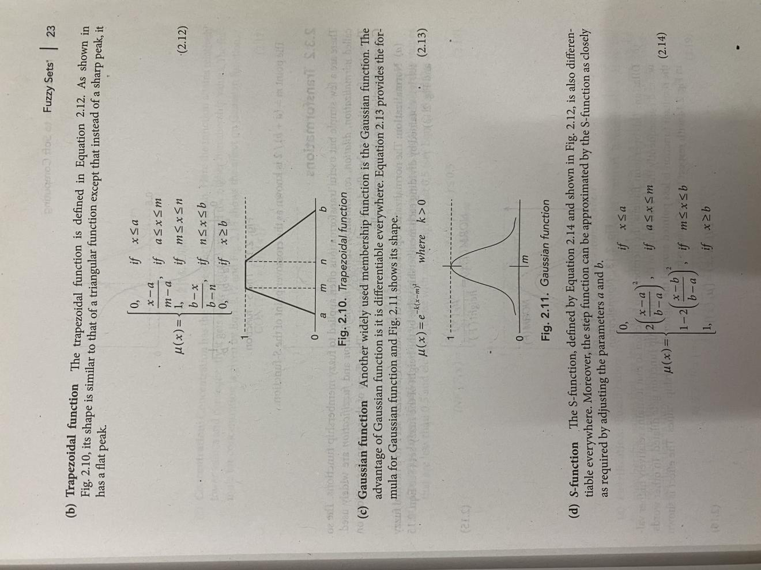

Slide 6
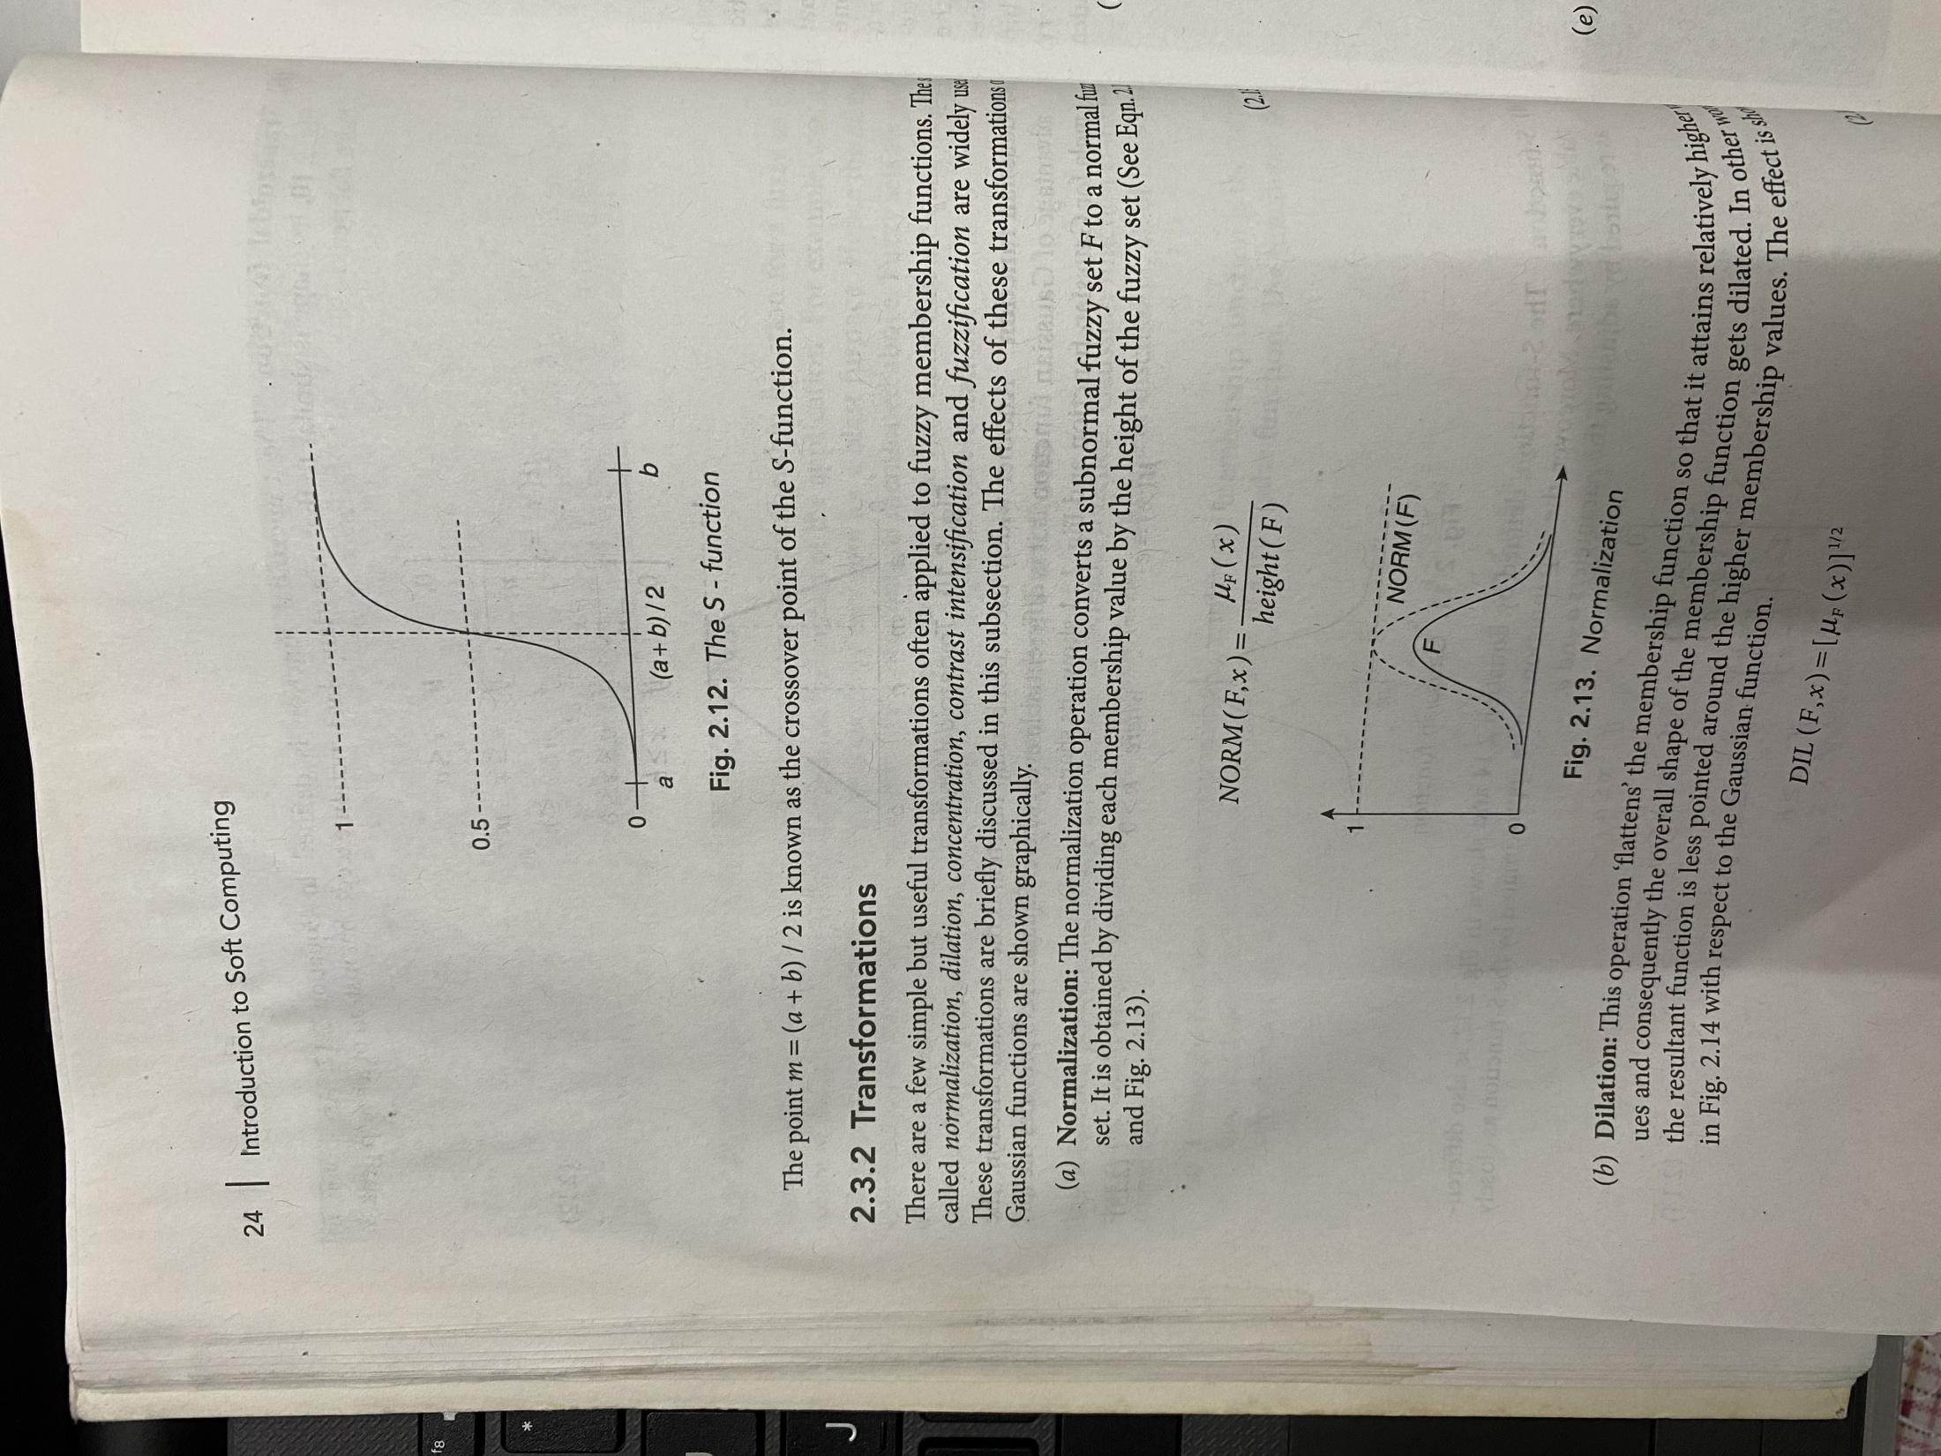

Slide 7
Fuzzy Logic Control(FLC) Systems
Introduction
FLC is the most active research area in the application of fuzzy set theory, fuzzy reasoning and fuzzy logic.
FLC appliactions extends from industrial process control to biomedical instrumentation and securities.
Compared to conventional control techniques , FLC has been best utilized in complex ill-defined problems, which can be controlled by efficient human operator without knowledge of their underlying dynamics.
The basic concept behind FLC is to “utilize the expert knowledge and experience of a human operator” for designing a controller for controlling an application process whose input-output relationship is given by a collection of fuzzy control rules using linguistic variables instead of a complicated dynamic model.
The fuzzy control rules are basically IF-THEN rules.
The linguistic variables, fuzzy control rules and fuzzy appropriate reasoning are best utilized for designing the controller.
The linguistic variable provides approximate characterization of a complex problem.

Slide 8
Basic structure and design methodologies of an FLC model.
FLC is strongly based on the concepts of
fuzzy sets,
fuzzy relations,
fuzzy membership functions,
defuzzification,
fuzzy rule-based systems and
approximate reasoning

Slide 9
Application of FLC Systems
FLC systems find a wide range of application in various industrial and commercial products and systems.
In several applications- related to nonlinear, time-varying, ill-defined systems and also complex systems -
FLC systems have proved to be very efficient in comparison with other conventional control systems.
The applications of FLC systems include:
1. traffic control;
2. steam engine;
3. aircraft flight control;
4. missile control;
5. adaptive control;

Slide 10
6. liquid-level control;
7. helicopter model;
8. automobile speed controller;
9. braking system controller;
10. process conuol (includes cement kiln comrol);
11. robotic control;
1.2. elevator (aum lift) comrol;
13. automatic runing control;
14. cooling plant control;
15. water uearment;
16. boiler control;
17. nuclear reactor control;
18. power systems control;
19. air conditioner control (temperature controller);
20. biological processes;
21. knowledge based system;
22. fault detection control unit;
23. fuzzy hardware implementation and fuzzy computers.

Slide 11
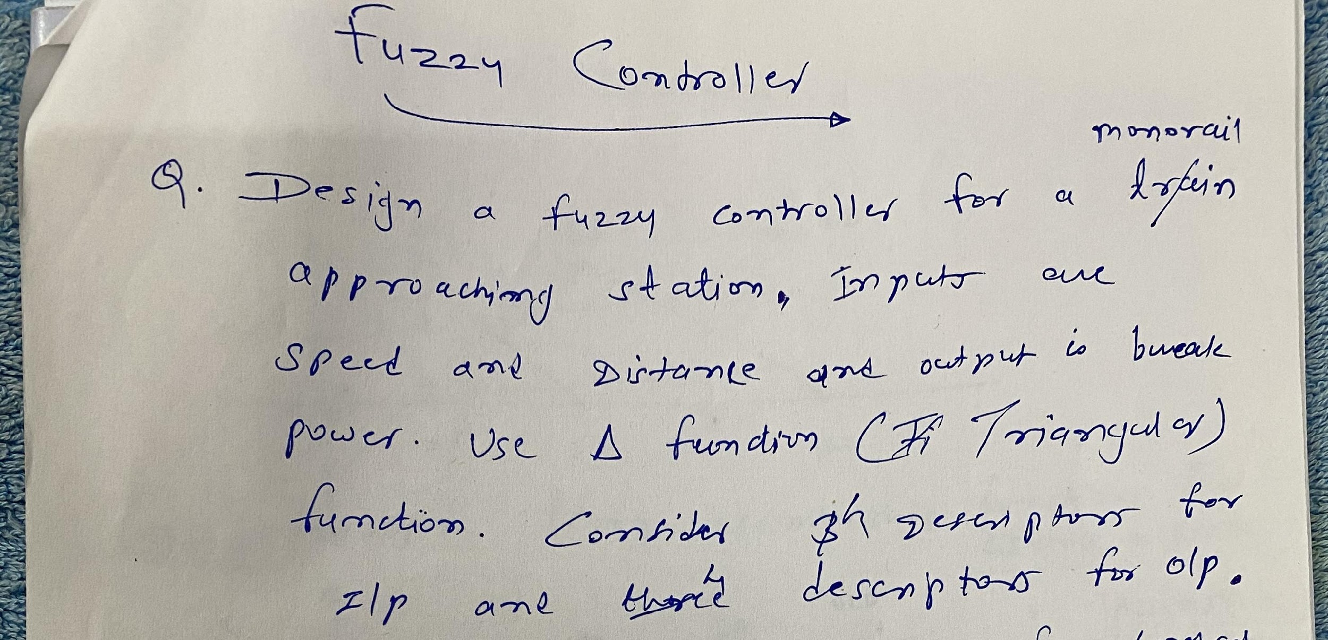

Slide 12
Fuzzy system Basic Components
Crisp Input ---->Fuzzification------>Rules---->Defuzzification---->Output Result

Slide 13
Steps Involved :
1.Define the fuzzy membership functions for the state variables (Distance and Speed).
2. Define the fuzzy membership function for lhe output variable (break power).
3. Form the fuzzy rule base system model.
Based on the fuzzy rules, form the fuzzy associative memory (FAM) table. The values in the FAM table give the output (Break power).
4. Define the initial conditions
5. Defuzzification and carry out simulation for one cycle.

Slide 14
Steps and theory from Ch 14 Deepa’s Book

Slide 15
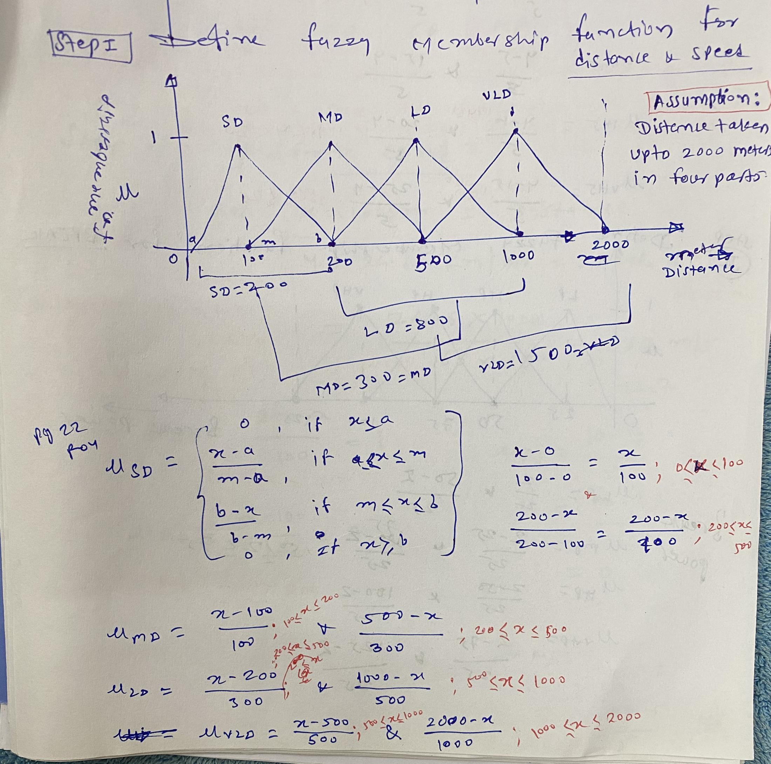

Slide 16
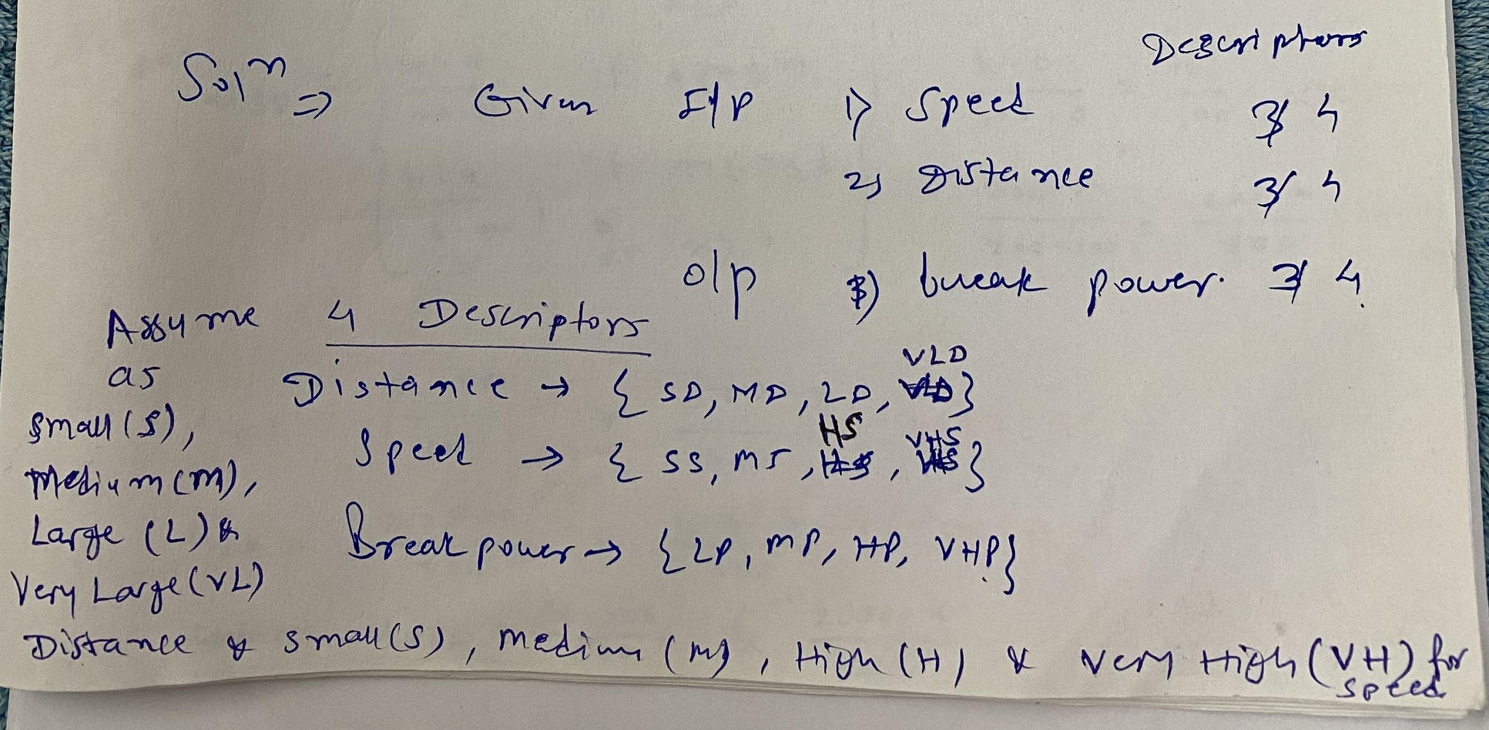

Slide 17
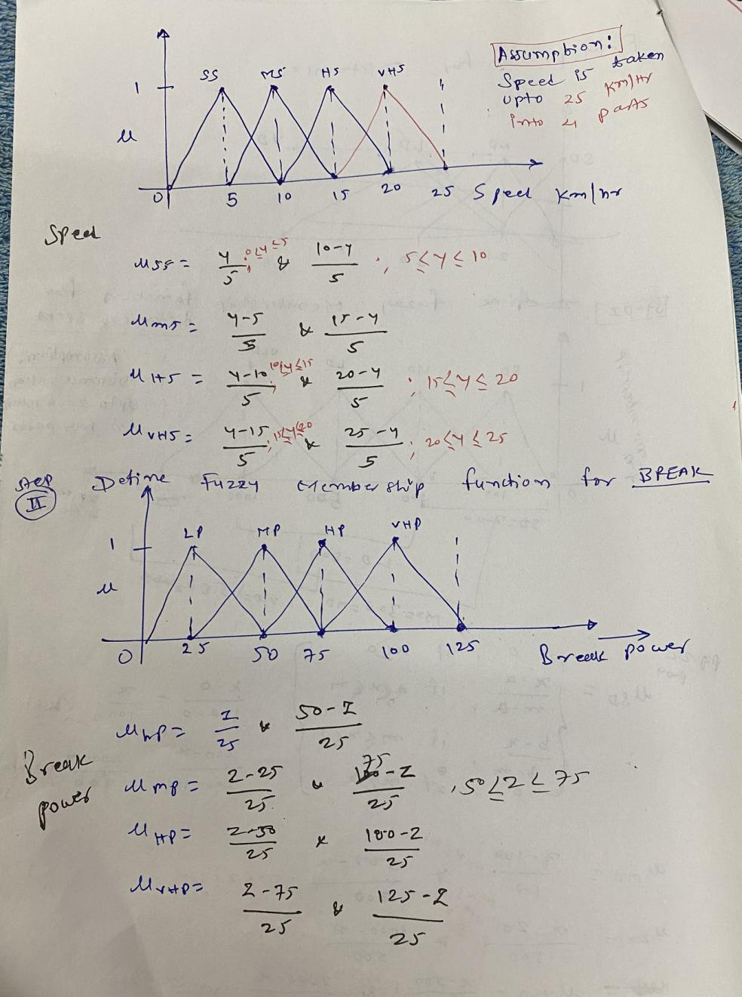

Slide 18
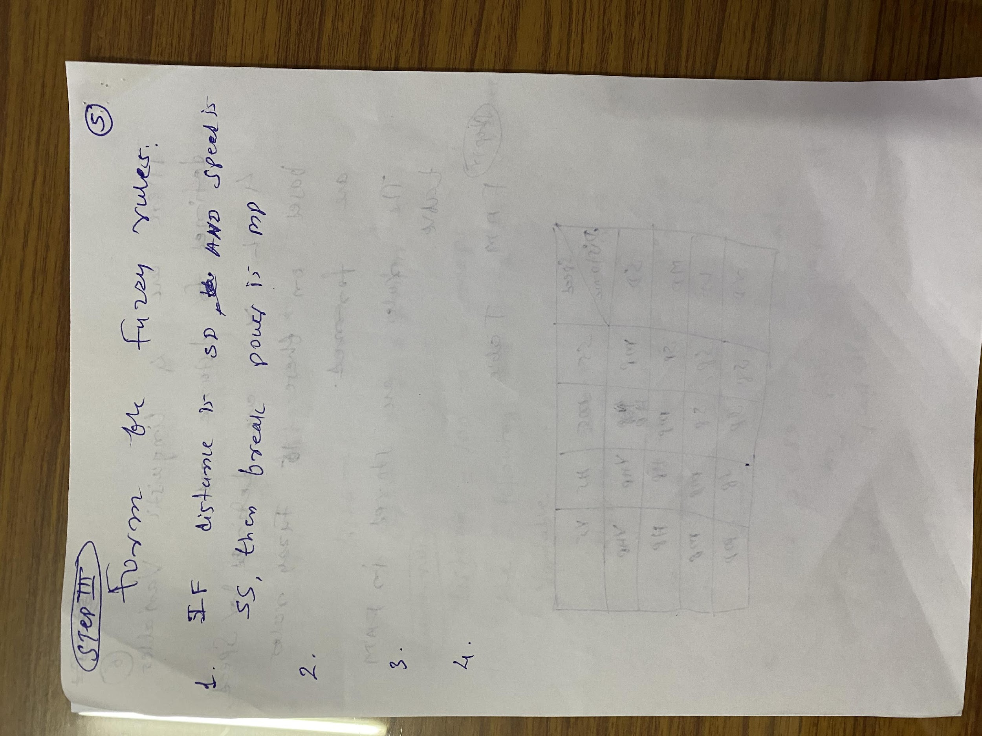

Slide 19
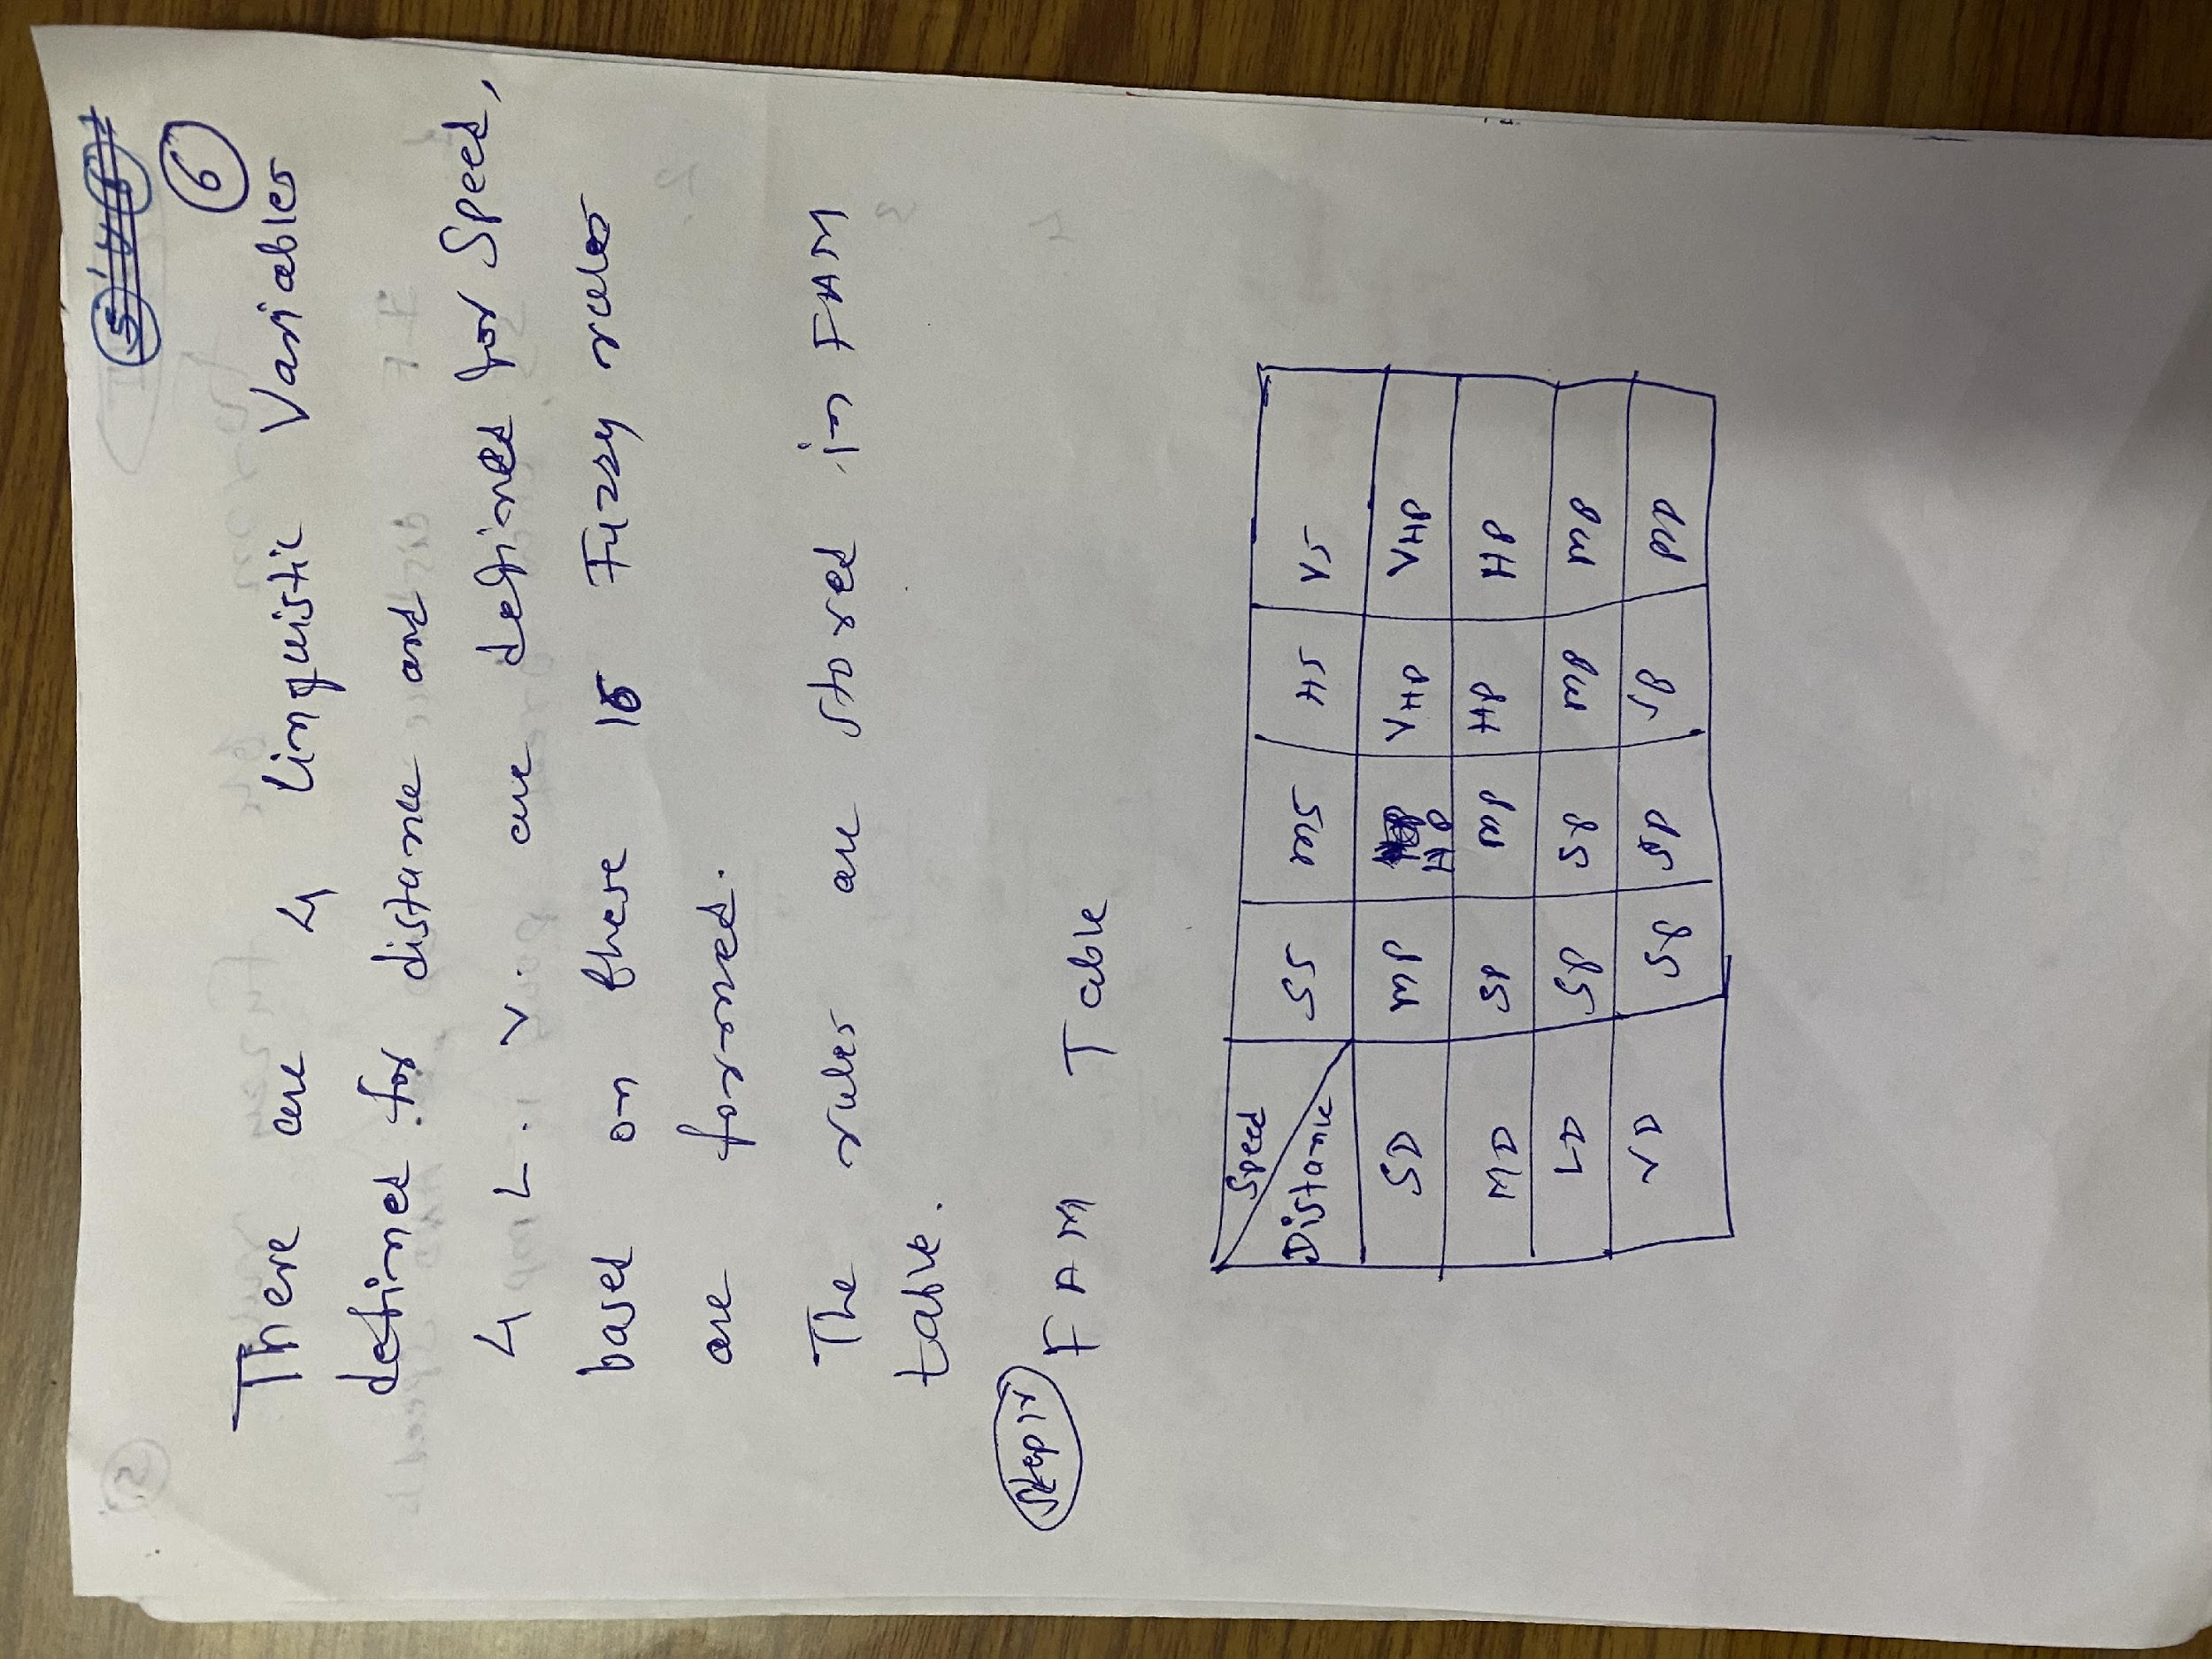

Slide 20
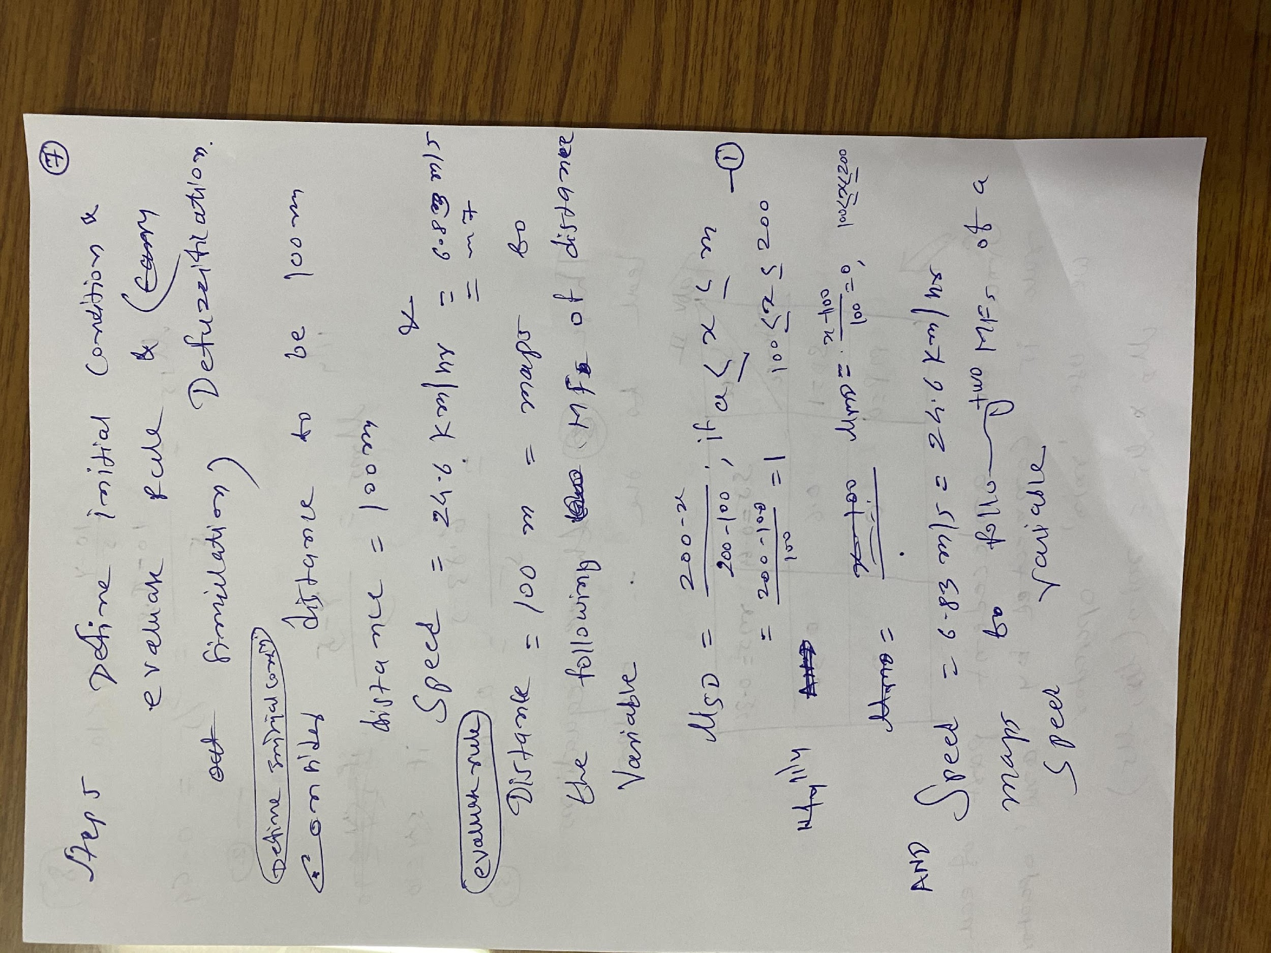

Slide 21
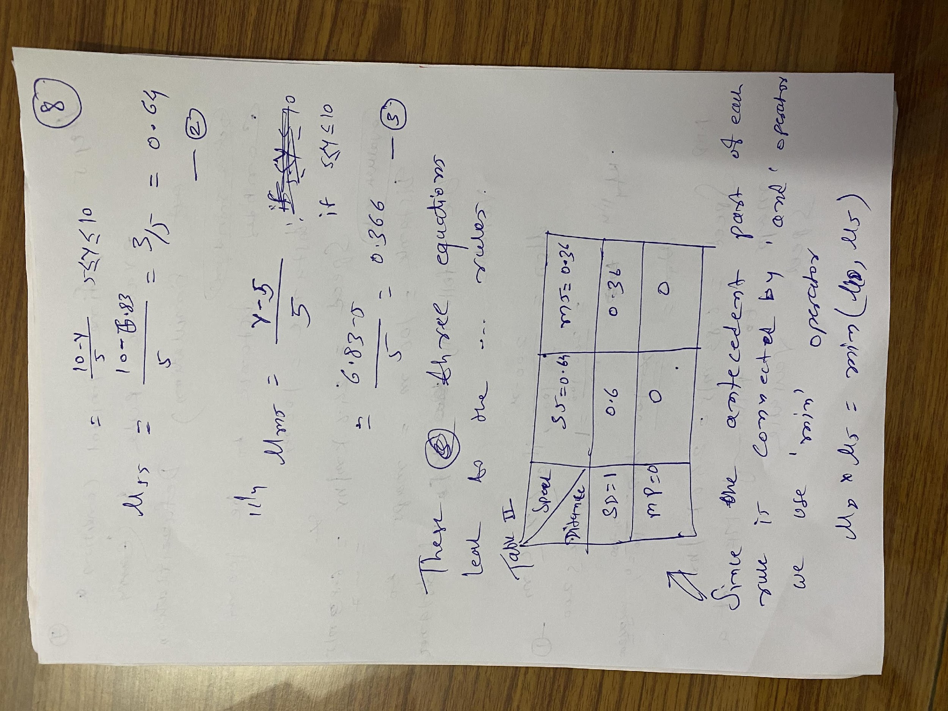

Slide 22
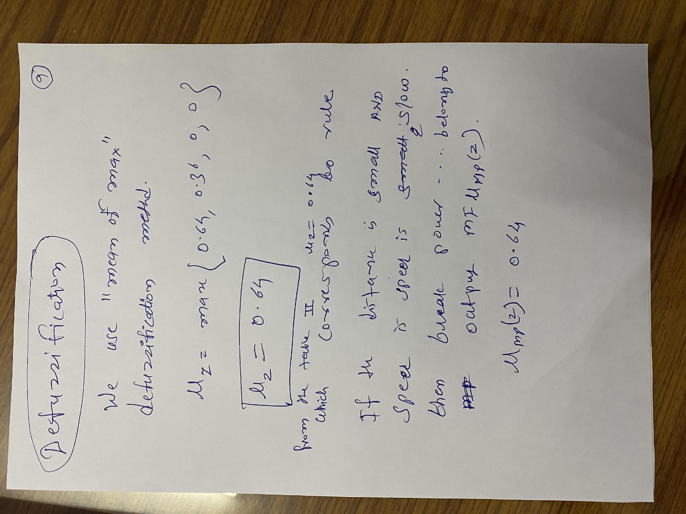

Slide 23
